Slide 1



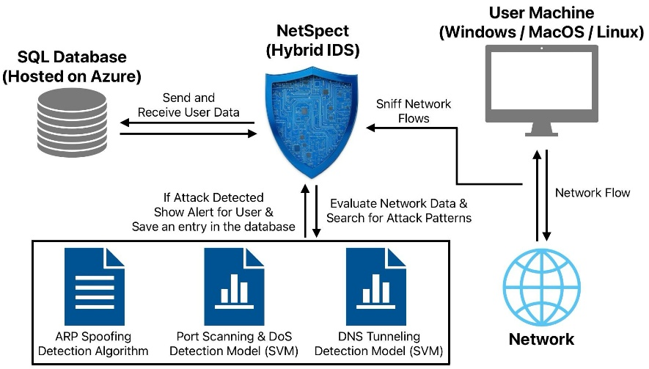
SE – A – 14
Software Engineering
Students: Shay Hahiashvili | Maxim Subotin
Advisor: Ms. Alona Kutsyy
Anomaly Based Detection
Collection Methods
We developed two SVM models designed to classify network cyberattacks in real time. The first model targets the detection of Port Scanning and DoS attacks, while the second identifies DNS Tunneling. In our approach we applied a unique traffic segmentation method and robust feature selection, along with K-Fold cross-validation to ensure model reliability and generalization. This enabled both models to achieve real-time detection capabilities with a remarkable 100% accuracy.
Collected network traffic from home networks and the SCE campus.
Simulated DNS traffic using custom scripts.
Generated attack datasets from small samples via feature correlation and randomization.
Applied Round-Robin segmentation to organize packets into flows.
Flows: (src_ip, src_mac, dst_ip, dst_mac, protocol)
NetSpect
Hybrid Intrusion Detection System
GitHub
Signature Based Detection
Main Features
We developed a unique algorithm capable of detecting ARP Spoofing attacks in real time across multiple subnets. The algorithm incorporates an authentication mechanism for each IP-MAC address pair within every subnet, enabling accurate identification of both IP-to-MAC and MAC-to-IP anomalies. Furthermore, it intelligently adapts to legitimate network changes, such as DHCP lease renewals for dynamic IP addresses. As a result, our algorithm delivers real-time detection with high accuracy and is resistant to false positives.
Real Time Detection, Data Collection, Download Reports, Filter Previous Alerts by Year, Visual Analytics, Tray Icon Notifications, Light/Dark Modes, Integrated Logger, etc.
Datasets
UDP & TCP
393,000
Featuring: number of ports, SYN flag count, packets per second, IATs, etc.
DNS
360,000
Featuring: TXT record count, number of unique sub domains, DF flag count, etc.

Slide 2

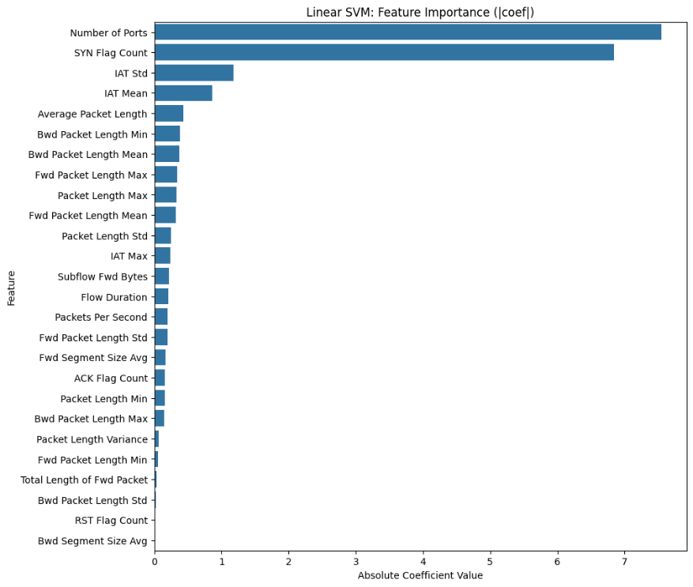
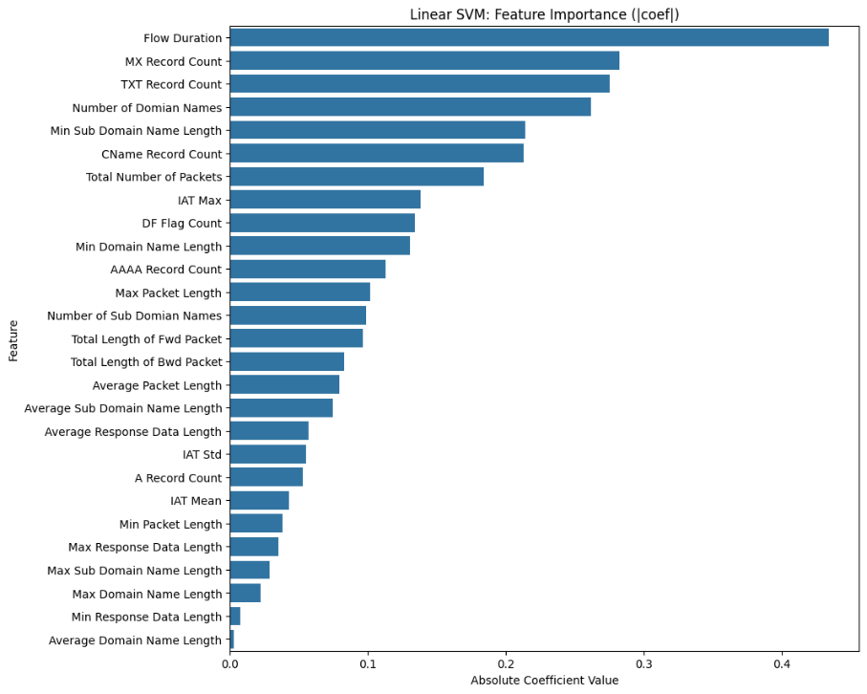
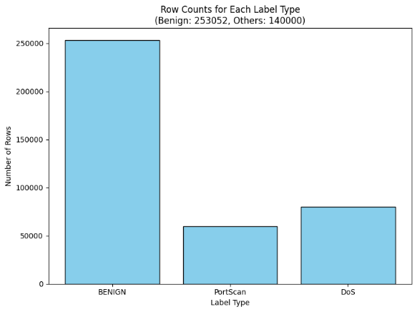
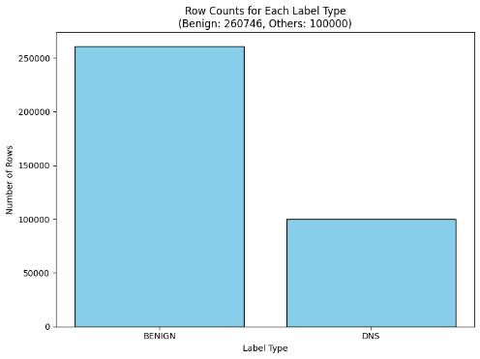
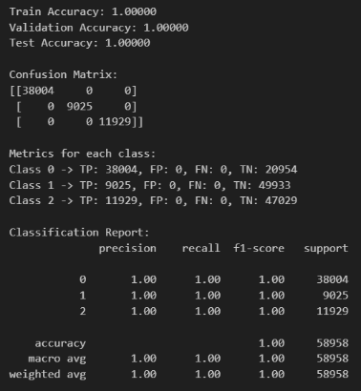
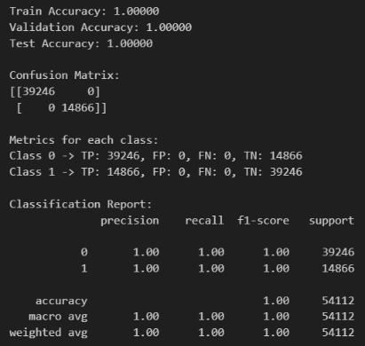
SE – A – 14
Software Engineering
Students: Shay Hahiashvili | Maxim Subotin
Advisor: Ms. Alona Kutsyy
Port Scan & DoS Results
DNS Tunneling Results
Conclusions
In conclusion, our project successfully delivered a real-time IDS capable of accurately identifying four critical types of network cyber attacks: Port Scanning, DoS, ARP Spoofing, and DNS Tunneling through an optimized, multi-threaded solution integrating detection algorithms and machine learning models. By addressing the limitations of existing datasets through manual data collection, the system achieves high accuracy with minimal false positives, offering a reliable and user-friendly solution for modern network security challenges.
Port Scanning - DoS SVM Model K-Fold Cross Validation :
DNS SVM Model K-Fold Cross Validation :
Fold | Train Accuracy | Validation Accuracy | Precision | Recall | F1-Score | Samples
1 | 1.0000 | 1.0000 | 1.00 | 1.00 | 1.00 | 25,436
2 | 1.0000 | 1.0000 | 1.00 | 1.00 | 1.00 | 25,436
3 | 1.0000 | 1.0000 | 1.00 | 1.00 | 1.00 | 25,436
4 | 1.0000 | 1.0000 | 1.00 | 1.00 | 1.00 | 25,436
5 | 1.0000 | 1.0000 | 1.00 | 1.00 | 1.00 | 25,436
6 | 1.0000 | 1.0000 | 1.00 | 1.00 | 1.00 | 25,436
7 | 1.0000 | 1.0000 | 1.00 | 1.00 | 1.00 | 25,435
8 | 1.0000 | 1.0000 | 1.00 | 1.00 | 1.00 | 25,435
9 | 1.0000 | 1.0000 | 1.00 | 1.00 | 1.00 | 25,435
10 | 1.0000 | 1.0000 | 1.00 | 1.00 | 1.00 | 25,435
Fold | Train Accuracy | Validation Accuracy | Precision | Recall | F1-Score | Samples
1 | 1.0000 | 1.0000 | 1.00 | 1.00 | 1.00 | 25,253
2 | 1.0000 | 1.0000 | 1.00 | 1.00 | 1.00 | 25,253
3 | 1.0000 | 1.0000 | 1.00 | 1.00 | 1.00 | 25,252
4 | 1.0000 | 1.0000 | 1.00 | 1.00 | 1.00 | 25,252
5 | 1.0000 | 1.0000 | 1.00 | 1.00 | 1.00 | 25,252
6 | 1.0000 | 1.0000 | 1.00 | 1.00 | 1.00 | 25,252
7 | 1.0000 | 1.0000 | 1.00 | 1.00 | 1.00 | 25,252
8 | 1.0000 | 1.0000 | 1.00 | 1.00 | 1.00 | 25,252
9 | 1.0000 | 1.0000 | 1.00 | 1.00 | 1.00 | 25,252
10 | 1.0000 | 1.0000 | 1.00 | 1.00 | 1.00 | 25,252

